Slide 1
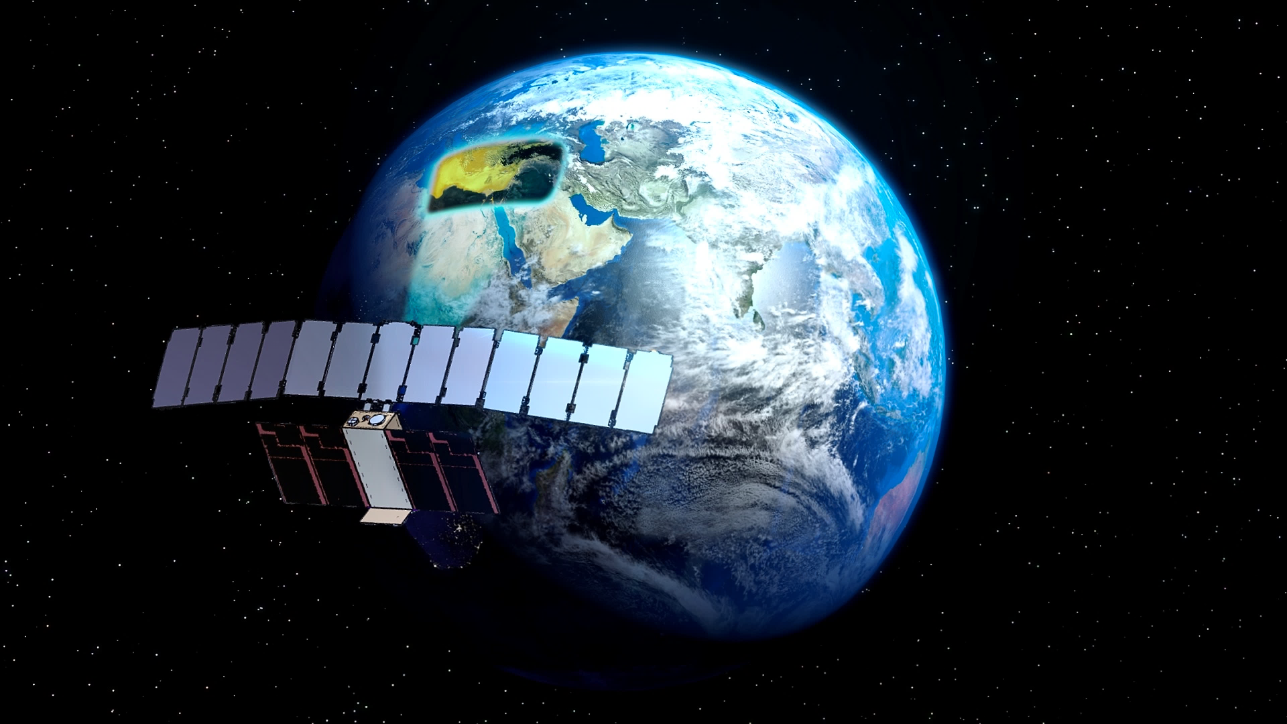
SATURN
Synthetic AperTure radar cUbesat foRmation flyiNg
Trym Varland
Credit: https://www.nanosats.eu/sat/saturn

Slide 2
Content
The new era of remote sensing?
SATURN – overview
How does it work?
Configurations
Why is this suitable?
Target/application
State of the art/ways forward
Is this the new era?
Notes:
Suitable for ocean monitoring
Target/ application which is ocean monitoring

Slide 3
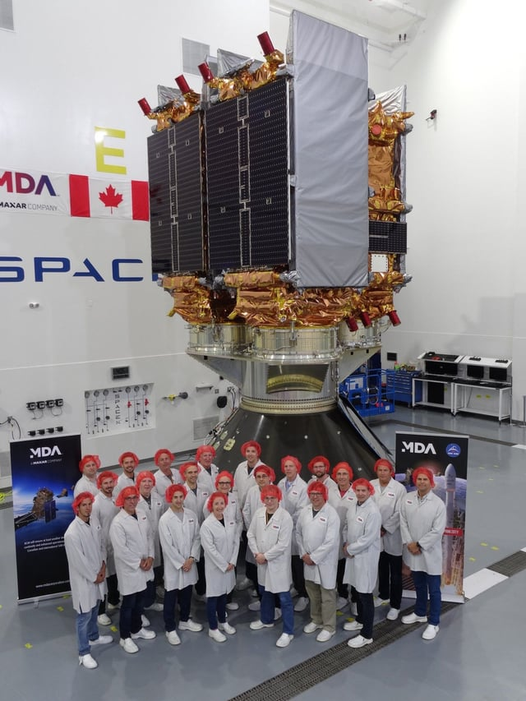
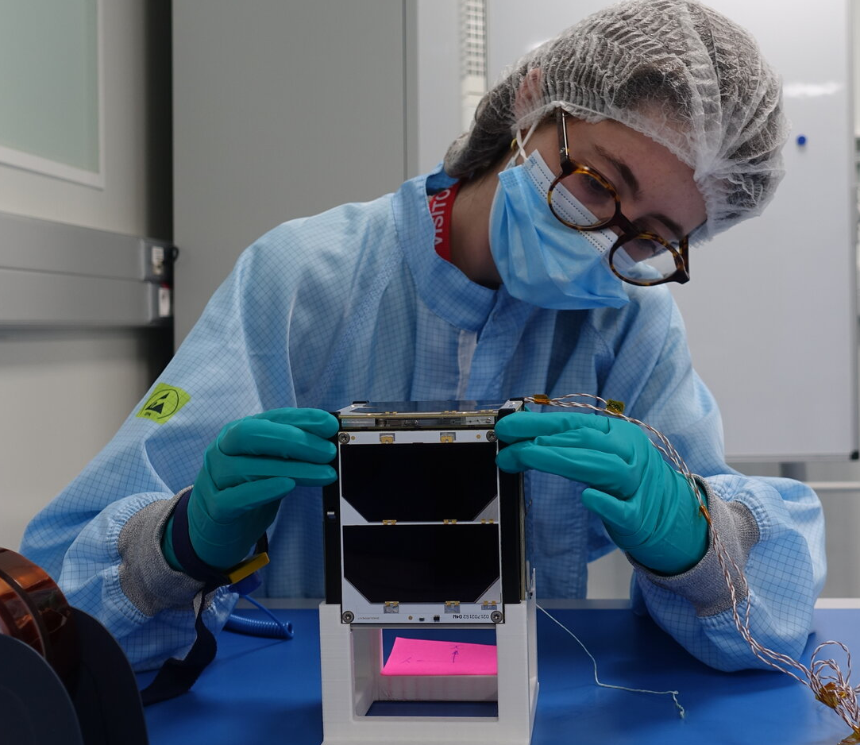
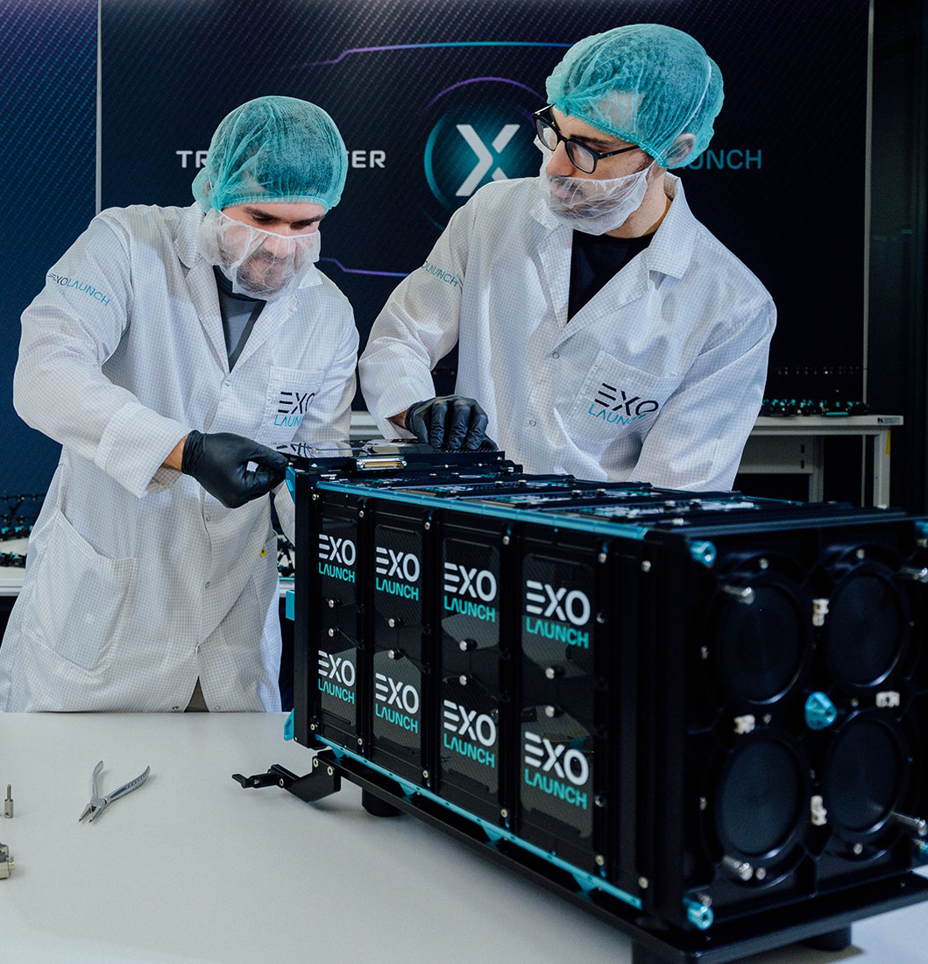
The new era of remote sensing?
Average SAR satellite
From 4m to 20m (antenna size)
> ~400kg
High-cost
Satellites required: ~1
CubeSat
1U = 10x10x10cm
~2kg
Low-cost
As many as you like
https://www.reddit.com/r/spacex/comments/byzxx6/after_years_of_hard_work_and_dedication_canadas/
https://www.esa.int/Education
https://www.exolaunch.com/news_100.html
Notes:
On the radarsat-2 only the antenne weigh 700kg and is 15m long seen in the top rigth corner. SAR satellites from ICEeye an private company in Finland, have an antenna length of 4m and weight of 770kg of the satellite. But they also have smaller SAR satellites with an weigth of 90kg, but the smallnes of the satellite impacts the resolution. This is thought to be the smallest size of an SAR satellites.

Slide 4
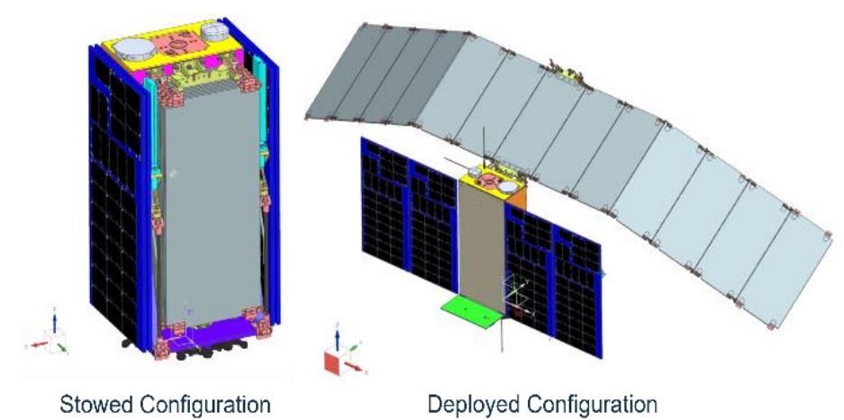
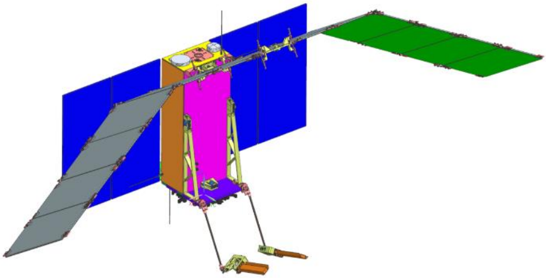
SATURN - overview
Synthetic AperTure radar cUbesat foRmation flyiNg
Parameters
16U ~ 30x30x60cm
38.7kg
Coherent SAR formation
Using 3 CubeSats
Low Earth Sun Synchronous orbit
Revisit time 20.4h, interferometric revisit time 4 days
Miniaturized SAR instrument
Resolution 5x5m, high-res 1.5x1.5m, 30km swath
Image Size, 30x50km
Utilizing MIMO (Multiple-Input-multiple-Output)
Launch date: 2025-12-31

Slide 5
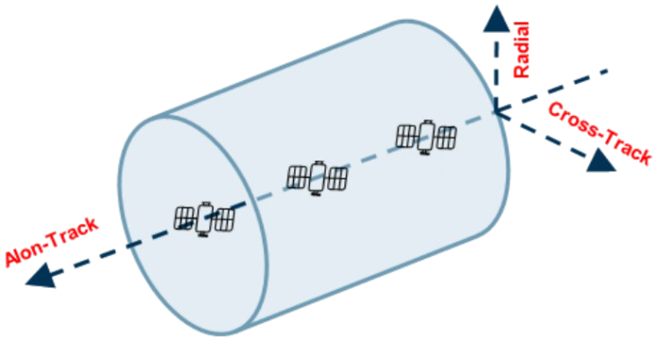
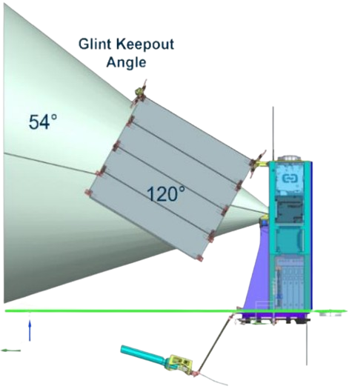
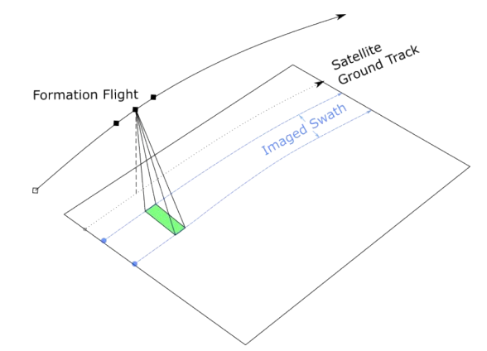
How does it work?
Along-track-train
+/- 5m
Restrictions
800m length
200m radius
Antenna
~3.9m
X-band SAR
13 panels
Single polarization (HH pol)
Notes:
So the SATURN mission works by using 3 satellites in close formation in an along-track train with a maximum distance of +/- 5m from each other including this they also have to move within an tube of about 800m length and 200m radius. This is necessary to synthesize an antenna of virtual bigger size. The data collected by each satellite in the formation will be downloaded to the ground segment and recombined to produce a single high-performance SAR image. This way we overcome the limitations of SAR imaging on CubeSat-sized satellites, as SAR imaging requires high power and the size of the SAR antenna is usually very large.
So about the SATURN instrument, it is an X-band SAR equipped with a reflect array antenna, composed by 13 panels, designed to work in single polarization (HH Pol) and acquiring the data in Stripmap mode. During the imaging, the SAR acquires the eco signals scattered by the imaged scene in response to the transmitted pulses, processes them, and then marges this data with timing and auxiliary information

Slide 6
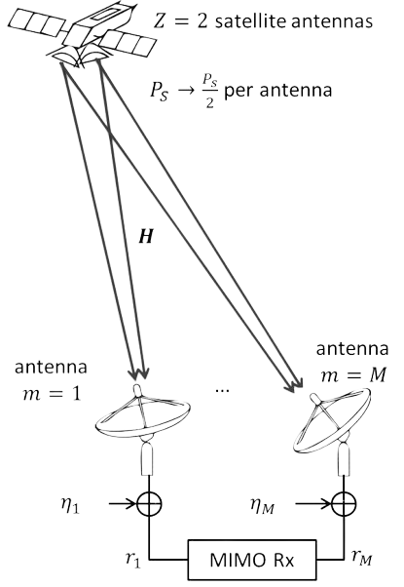
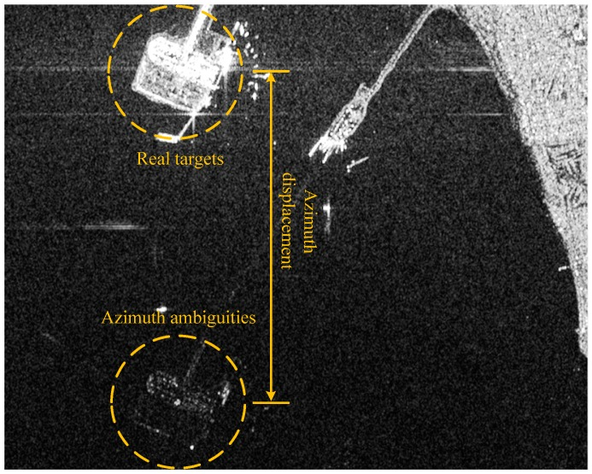
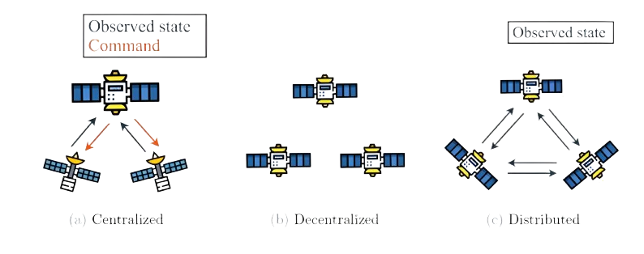
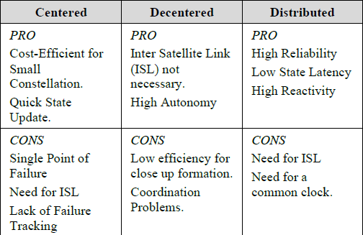
Configurations
MIMO (Multiple-Input-Multiple-Output)
The SAR Paradox
Centered, Decentered and distributed
Distributed
Notes:
So I am going to go through, some of the configurations of the satellites additionally to some more info.
So standard SAR satellites utilize SIMO (Single-Input-Multiple-Output), which would say that we have one sensor that transmits one signal and receives multiple. For this mission they will demonstrate MIMO (multiple-Input-Multiple-Output) which is based on cooperative active sensors, where each one transmits signals and receives the illuminated common area backscatter related to the entire swarm, increasing measurement performance with a trend approximatively equal to the square of the number of sensor. This enables us to overcome the SAR paradox, which comes from the Nyquist sampling theorem. In essence, the time between emitted radar pulses must exceed the time required to recover the echoes from the image swath otherwise the image will contain azimuth ambiguities.
Also another important factor of this mission is, how the satellite should correspond to each other. We could have centralized, decentralized or distributed link between them. Here we can see the pros and cons with the different configurations. For the mission they went with distributed configurations so that they don’t have an single point of failure.

Slide 7
Why is this suitable for ocean monitoring?
Low-cost
Potential gain in swath size
N-1 ambiguities being suppressed
Signal-to-noise ratio up to N^2
Benefits in redundancy and scalability
HH Polarization
Detecting and imaging surface features
Ocean monitoring
Notes:
As we work with lighter and smaller size satellites, there would be a drastically lower cost of these types of missions. We would possible have an gain in swath width as it proportional to the number of satellites due to N-1 ambiguities being suppress, and a signal-to-noise ratio gain up to N^2. As the mission utilizes multiple CubeSats, we get benefits in redundancy and scalability. As the satellites use horizontal polarization, which is effective for detecting and imaging surface features such as the ocean. Including this and the benefits above that I mentioned, these types satellite missions is useful in maritime tracking applications, where wide swaths of ocean can be scanned quickly and vessels detected from high-resolution imagery.

Slide 8
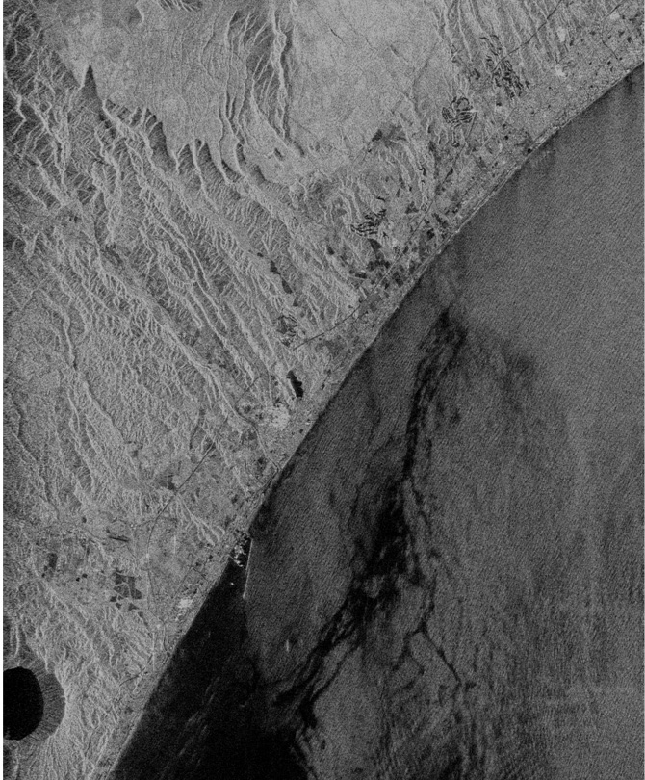
Target/Application
Demostration:
CubeSats utilizing SAR
MIMO
SAR imaging of highly reflective targets:
Manmade
Urban
Maritime surveillance
Ship Detection
Oil Spillage
https://www.eorc.jaxa.jp/ALOS/en/img_up/l_pal_pol_fig2_hh.htm

Slide 9
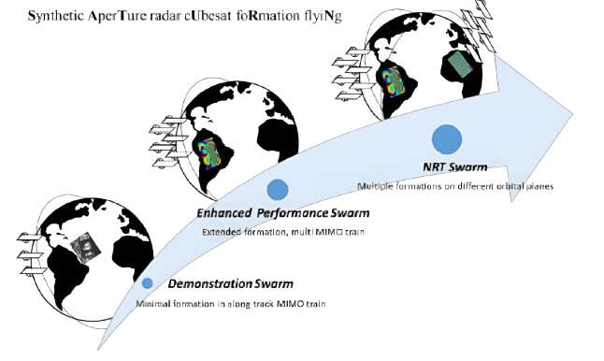
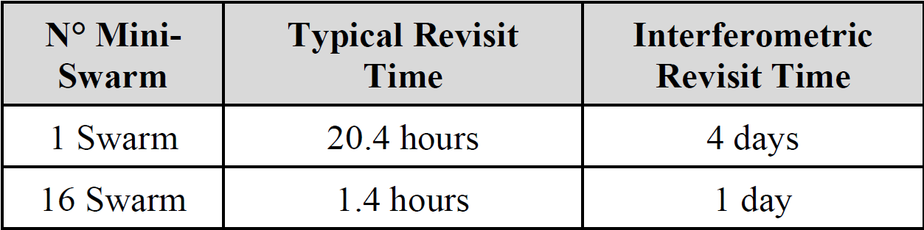
State of the art / ways forward
Demonstration Mission
Launch 2025-12-31
One Swarm – 3 CubeSats
16 swarms on 4 orbits

Slide 10
Is this the new era?
The advantages and disadvantages, would be highly dependent on several factors.
Advantages | Disadvantages
Low cost | Strict constraints
Gain in Swath Size | Need common clock
High Reliability | Complexity
High Reactivity | Requires multiple satellite to obtain desired resolution and revisit time
High resolution
Scalable
No single point of failure

Slide 11

Thanks, any questions?

Slide 12
References
https://www.politesi.polimi.it/retrieve/223a4406-3234-4ccb-9e3d-5791f05d6cb0/2022_04_Kelleher_01.pdf (Design of a MIMO SAR CubeSat Formation Flight Constellation for Maritime Surveillance)
https://digitalcommons.usu.edu/cgi/viewcontent.cgi?article=5541&context=smallsat (SATURN: a technological demonstration mission for distributed SAR Imaging)
M. Asiyabi, Reza & Ghorbanian, Arsalan & Nazarpour Tameh, Shaahin & Amani, Meisam & Jin, Shuanggen & Mohammadzadeh, Ali. (2023). Synthetic Aperture Radar (SAR) for Ocean: A Review. IEEE Journal of Selected Topics in Applied Earth Observations and Remote Sensing. PP. 1-38. 10.1109/JSTARS.2023.3310363.
https://secwww.jhuapl.edu/techdigest/Content/techdigest/pdf/V21-N01/21-01-Fried.pdf (Monitoring Hurricans Over the Ocean with Wide Swath SAR
https://eo4society.esa.int/wp-content/uploads/2022/07/2022-Riga_SAR-Marine_DVelotto_theory.pdf (SAR Marine Applications (oil spill and ship detection))
https://citeseerx.ist.psu.edu/document?repid=rep1&type=pdf&doi=604dbc68ed43411f07ffca2b19f7d819c6ae0480 (Ocean Monitoring with SAR: An overview)

